Slide 1
How to measure flow rate using
differential pressure transmitter

Slide 2
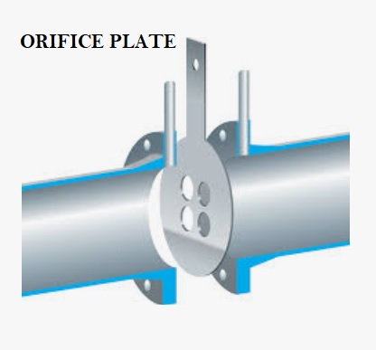
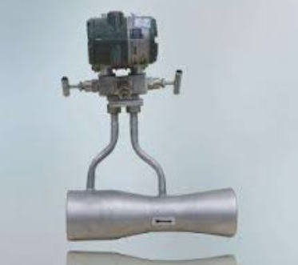
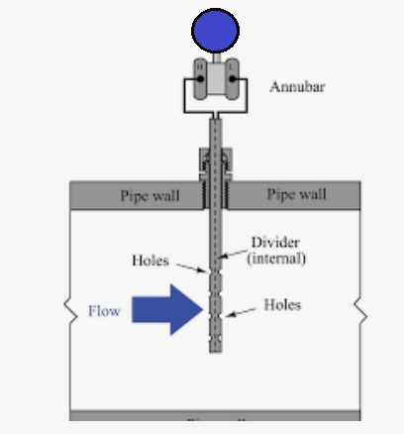
Sensing element to generate differential pressure
ventury

Slide 3
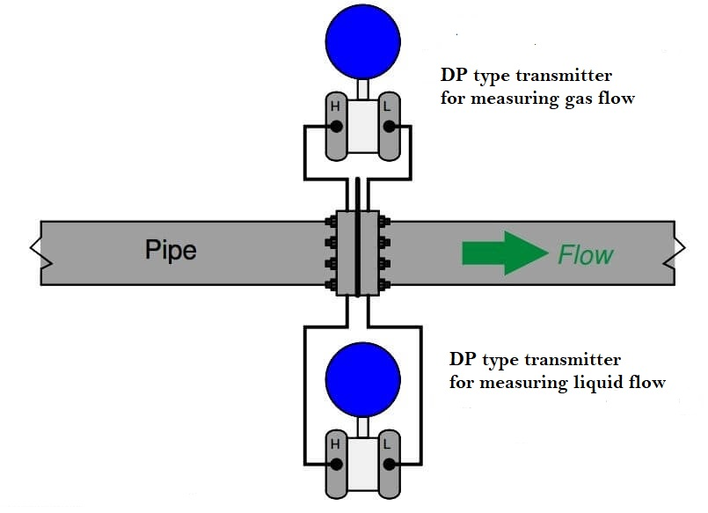
Flowmeter DP cell type installation method

Slide 4
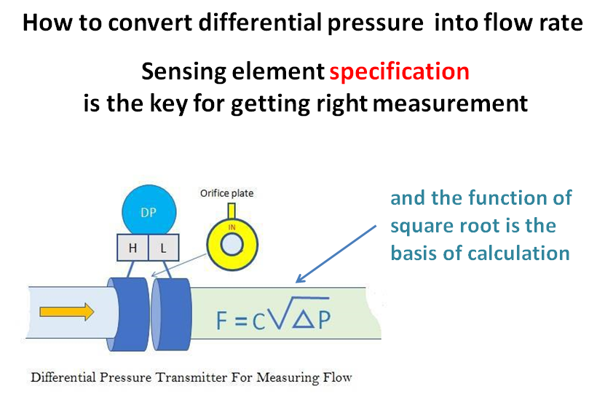

Slide 5
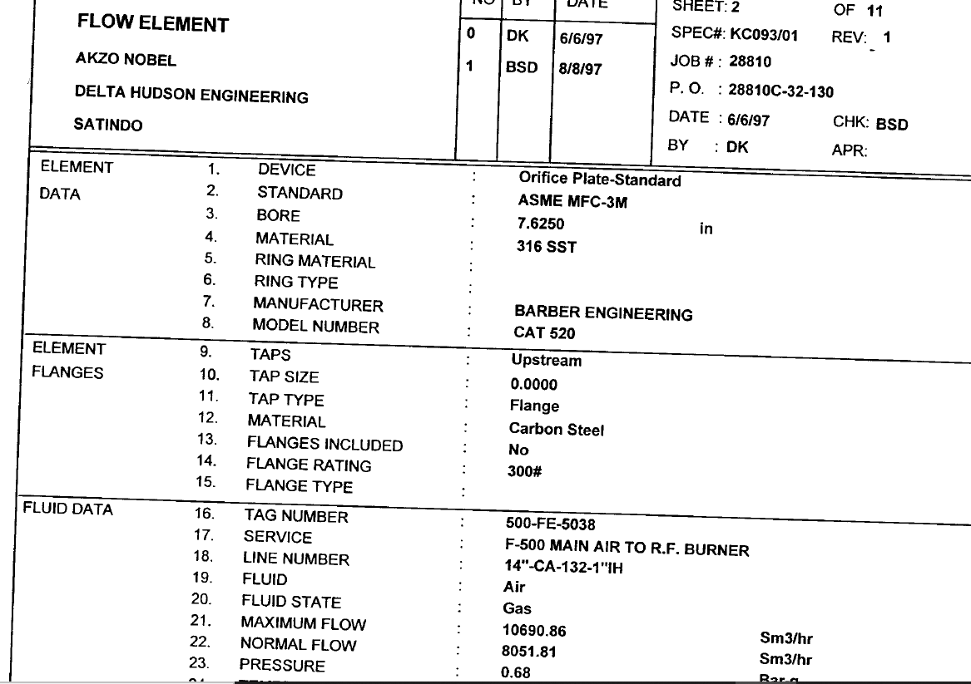
Sensing Element Data Specification Sheet

Slide 6
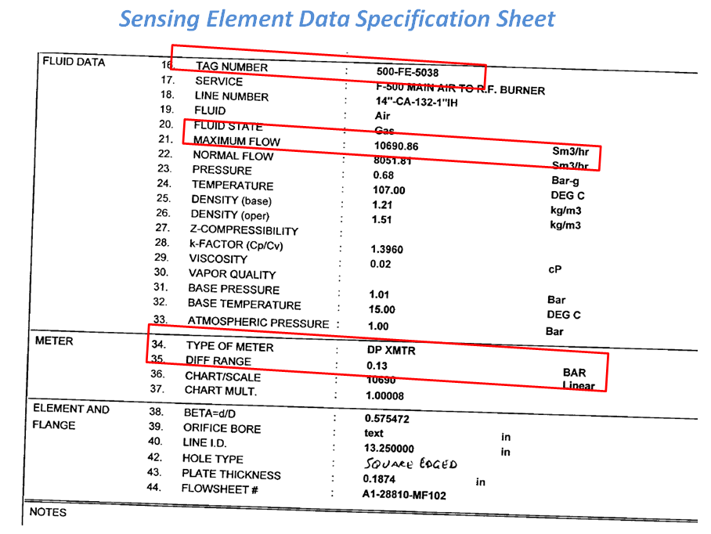

Slide 7
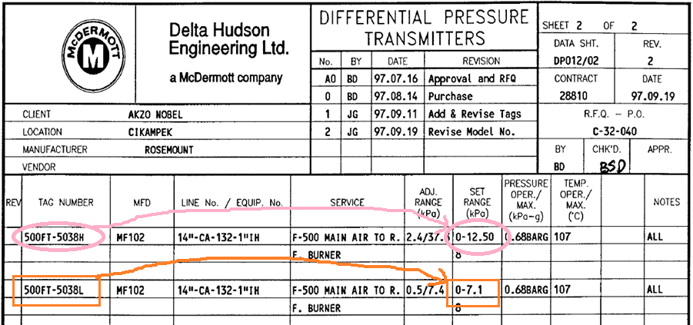
Transmitter Data Specification Sheet

Slide 8
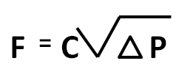
How to find correlation between differential pressure
against flow rate
Substitute data from sensing element into formula
F
=
Current Flow
C
=
Max. Flow rate
Max. Differential pressure
P
=
Current Differential Pressure
or use calculator available in the internet
https://www.jasaservis.net/calculator-flowmeter-dp

Slide 9
It is Blank Page

Slide 10
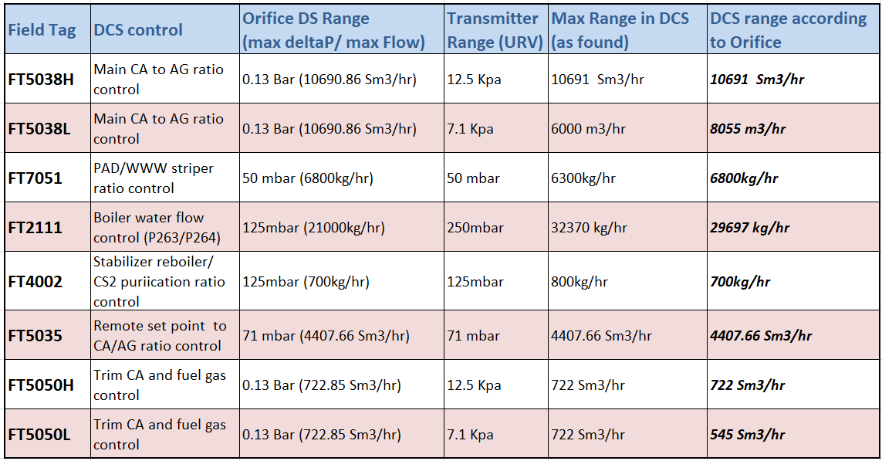

Slide 11
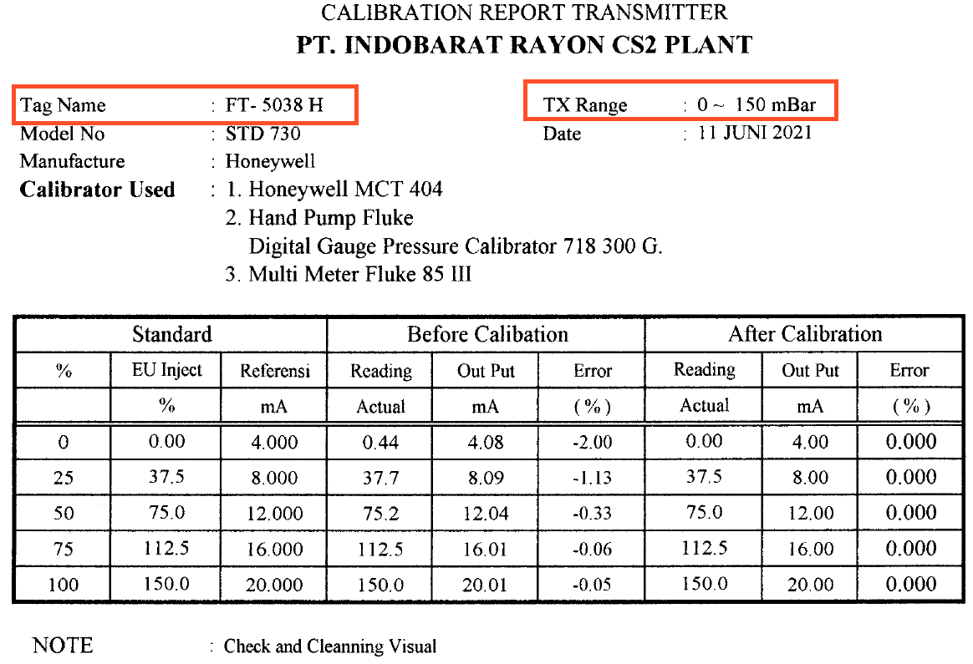
Notes:
Calibration not in square root mode

Slide 12
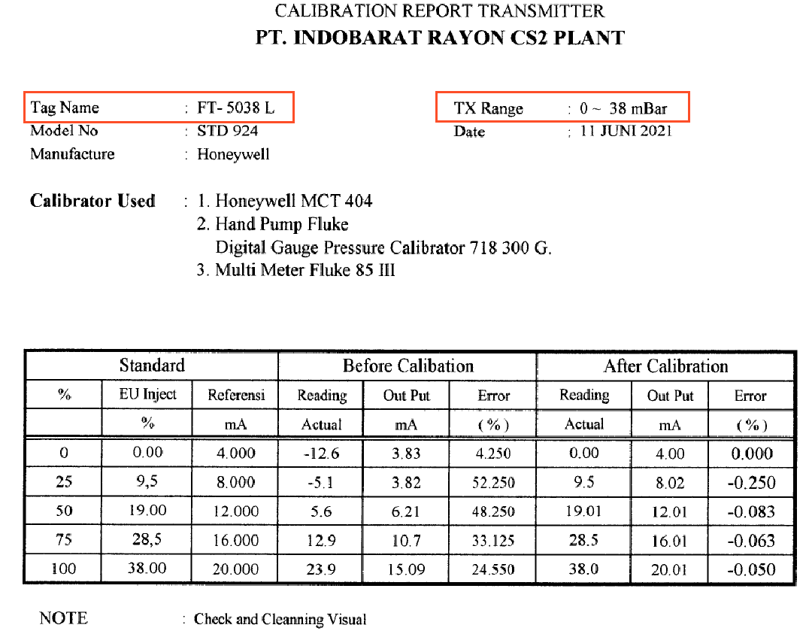

Slide 13
Follow up action
To rectify range discrepancies
&
To perform proper calibration
“If company gets profits with
deviation everywhere
definitely company shall get more profitable with right set up”
Notes:
We identify solution. We have to believe with statement

Slide 14
Thank you

